Slide 1
Hepatitis C prediction using PySpark and machine learning
BDSN PROJECT
AADITYA RAJ
A21037
DATA SOURCE LINK

Slide 2
TABLE OF CONTENTS
PAGE NO.
Problem Statement 3
Importance of problem to be solved 4
Data attributes description and Data set 5-6
Data visualization 7-13
Data preprocessing 14-16
Machine learning model and evaluation 17-18
Conclusion 19

Slide 3
PROBLEM STATEMENT
Hepatitis C is a liver infection caused by the hepatitis C virus (HCV). Hepatitis C is spread through contact with blood from an infected person. Today, most people become infected with the hepatitis C virus by sharing needles or other equipment used to prepare and inject drugs. For some people, hepatitis C is a short-term illness, but for more than half of people who become infected with the hepatitis C virus, it becomes a long-term, chronic infection. Chronic hepatitis C can result in serious, even life-threatening health problems like cirrhosis and liver cancer.
In this project we are going to creating a predictive model that could perform early detection of Hepatitis C and other liver diseases would allow people to quickly and easily determine their risk/get treatment.

Slide 4
IMPORTANCE OF THE PROBLEM TO BE SOLVED
Hepatitis C is an infection caused by a virus that attacks the liver and leads to inflammation. It is one of the deadly disease.
We don’t have a proper vaccination for this as well as early detection and screening is important because there is a better success rate and outcome if the disease is caught early before severe symptoms and complications occur. Early detection lowers the risk of worsening complications, such as a need for liver transplant, or cancer formation and death.
Through solving this we can detect the Hepatitis C disease patient in early stages and can be treated and ultimately we can save life by providing timely detection and treatement.

Slide 5
DATA SET DESCRIPTION
Category: The target feature. values: '0=Blood Donor', '0s=suspect Blood Donor', '1=Hepatitis', '2=Fibrosis', '3=Cirrhosis'
Age: age of the patient in years
Sex: sex of the patient ('f'=female, 'm'=male)
ALB: amount of albumin in patient's blood
ALP: amount of alkaline phosphatase in patient's blood
ALT: amount of alanine transaminase in patient's blood
AST: amount of aspartate aminotransferase in patient's blood
BIL: amount of bilirubin in patient's blood
CHE: amount of cholinesterase in patient's blood
CHOL: amount of cholesterol in patient's blood
CREA: amount of creatine in patient's blood
GGT: amount of gamma-glutamyl transferase in patient's blood
PROT: amount of protien in patient's blood

Slide 6
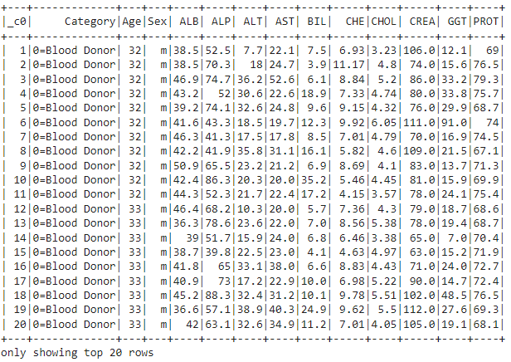
DATA SET

Slide 7
DATA VISUALIZATION

Slide 8
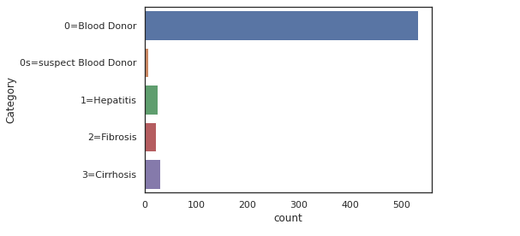
Here we can see that the count of Blood donor is highest among all

Slide 9
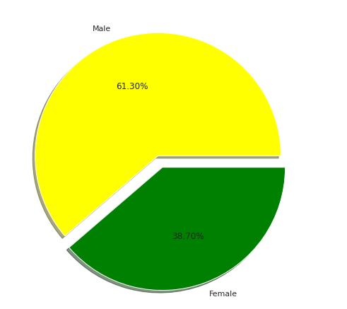
Males and females %
As we can see that Male percentage is more around 61.3%
And female % is 38.7

Slide 10
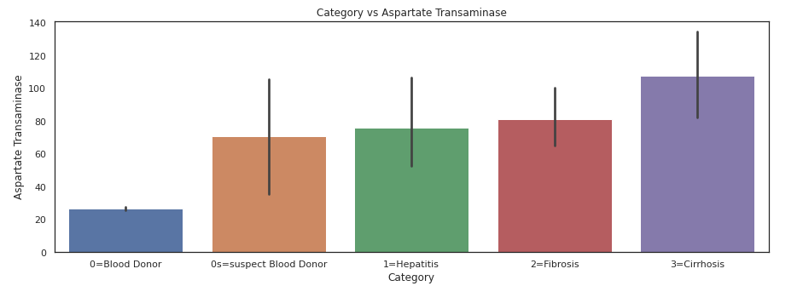
Aspartate transaminase(AST): AST is an enzyme that helps metabolize amino acids. Like ALT, AST is normally present in blood at low levels. An increase in AST levels may indicate liver damage, disease or muscle damage.
As we can see that AST level is highest in Cirrhosis

Slide 11
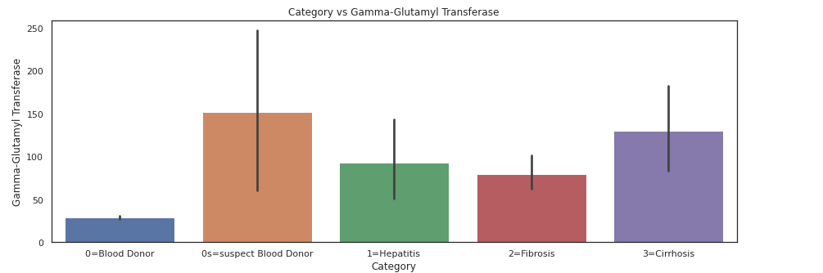
Gamma-glutamyltransferase (GGT): GGT is an enzyme in the blood. Higher-than-normal levels may indicate liver or bile duct damage.
In this case we can see that for the catrgory suspect blood donor and Cirrhosis GGT is higher

Slide 12
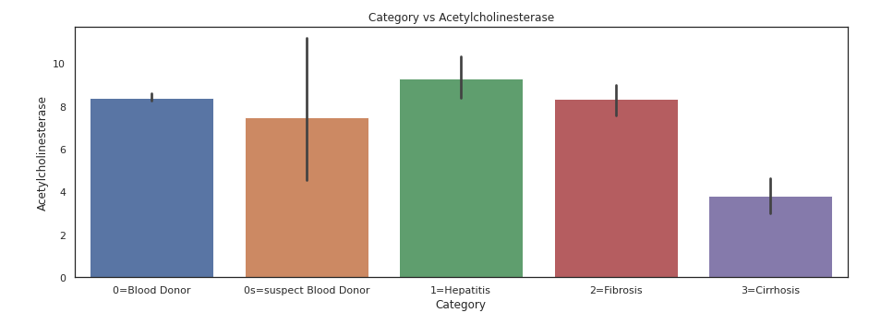
Acetylcholinesterase:
It is basically an enzyme that causes rapid hydrolysis of acetylcholine. Its action serves to stop excitation of a nerve after transmission of an impulse.
We can see that the level is highest in Hepatitis category

Slide 13
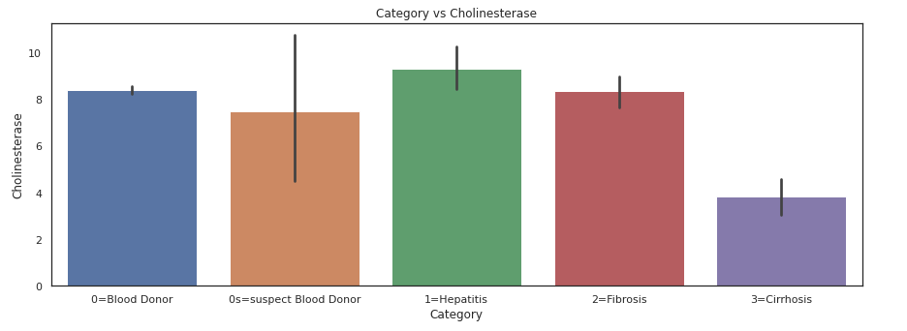
Cholinesterase:
Cholinesterase is a family of enzymes that catalyzes the hydrolysis of the neurotransmitter acetylcholine (ACh) into choline and acetic acid, a reaction necessary to allow a cholinergic neuron to return to its resting state after activation.
The level of cholinesterase is more in Hepatitis

Slide 14
DATA PRE-PROCESSING

Slide 15
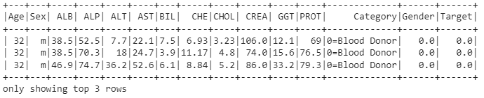
Now in the step we need to pre process some of our variable so as to fit the model on top of it. We need to transform the feature through label encoder technique so as to use the important variables for modeling.
Here we are going to label encode the sex column and categories of the target column to gender as

Slide 16
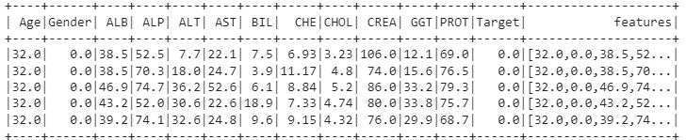
Here using Vector Assembler we are combining the values of all the features together in features column

Slide 17
Machine Learning Models and Evaluation

Slide 18


Now we are going to split our data into training and test set so as to prepare the data to fit into the model.
For this purpose we are using 70% of the data for training and 30% of the data for testing /Validation purpose. Further we import the machine learning models we need to apply. In this case we are going to apply linear regression and decision tree classifier and then we fit our training set in the model.
After training the model we predict the data based on the test set and finally based on the metrics we will evaluate the model performance.
The metrics like accuracy, Precision , Recall was used in this case to evaluate the model performance

Slide 19
CONCLUSION
As we have seen that the level of proteins and amino acids in the patient's blood is a good indicator to their risk of liver disease. This is especially true for certain combinations of these items as we have seen in data visualization.
Level of aspartate aminotransferases in a patient's blood contributes significantly more to the ensemble model than any other feature. As shown in the visualization graphs, the greater the AST level, the higher chance of being classified as having a liver disease.
The final model has an accuracy – 98%, precision – 0.8, recall – 1.0. We have used logistic regression model and random forest model.
Our main aim and objective is to predict the condition of the patients based on the available medical data/features/level of enzymes.

